Slide 1
进展
1. 将穿墙场景导入系统，解决了一些报错，录入Berg量表的动作。
2. 为训练场景添加射门动画。
3. 阅读一篇文章。

Slide 2
Developing Home-Based Virtual Reality Therapy Interventions
Games for Health Journal
Impact Factor: 2.224

Slide 3
Introduction
1. Stroke is one of the leading causes of serious long-term disability.
2. Current patients recovering from a stroke were conducting only 10–40 repetitions of a strengthening movement during a therapy session.
3. However, animal models have suggested hundreds of repetitions are needed to improve functional arm movements.
4. The use of VR has the possibility to increase the duration, frequency, and intensity of therapy to help retrain the patient’s movements.

Slide 4
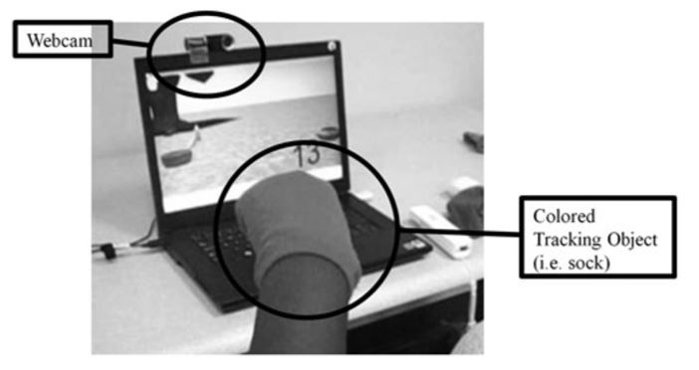
Methods
1. Participants
(1) Patient 1 was a 57-year-old woman who had had a stroke 10 years ago.
(2) Patient 2 was a 48-year-old woman who had had a stroke 1.5 years ago.
2. Devices
(1) The Wii remotes(Nintendo of America, Redmond, WA)
(2) The Bluetooth
(3) A personal computer
(4) A Webcam

Slide 5
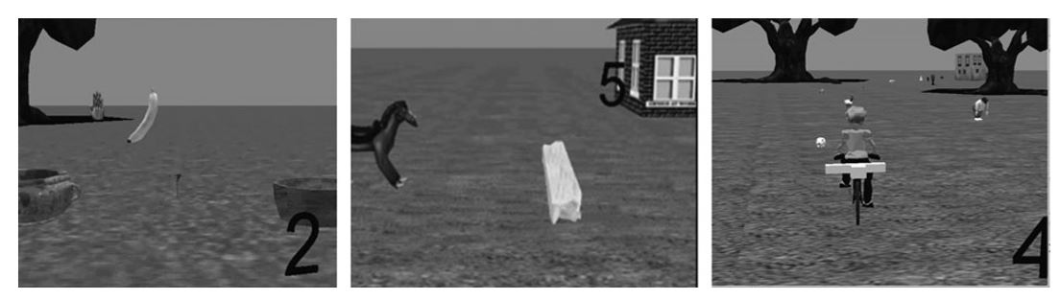
Methods
3. VR games
(1) Organization and recycling game: the participant controlled a virtual hand and placed food and non-food items to its appropriate basket.
(2) Horse riding game: the participant controlled the horse to jumped over various objects.
(3) Bike riding game: the participant controlled the movements of a virtual bike rider running over objects.

Slide 6
Methods
4. Home therapy
(1) Play each of the three games at home for 20 minutes, totaling 1 hour per day, for 7 days a week, 6 weeks.
(2) The participant met with the student researcher and computer scientist once a week to discuss these topics and to allow the researcher to modify the games based on her needs.
5. Measurements
(1) Canadian Occupational Performance Measure (COPM) for participant’s goals and priorities.
(2) Motor Activity Log(MAL, 每日活动记录) for participant’s perceived improvement.
(3) Action Research Arm Test (ARAT) : Grasp, Grip, Pinch, and Gross Movement.
(4) A goniometer(角度计) was used to measure the participant’s current range of motion.

Slide 7
Results
1. COPM
(1) For Participant 1, a 1 point change was found in the Performance and Satisfaction scores.
(2) Participant 2 showed a 1.6 point increase in her Performance score and a 1.8 point increase in her Satisfaction score.
2. MAL
(1) Participant 2 demonstrated improved use of her affected arm in wiping off the kitchen counter, picking up a cup by the handle, cutting food with a fork and knife, and cooking a meal.

Slide 8
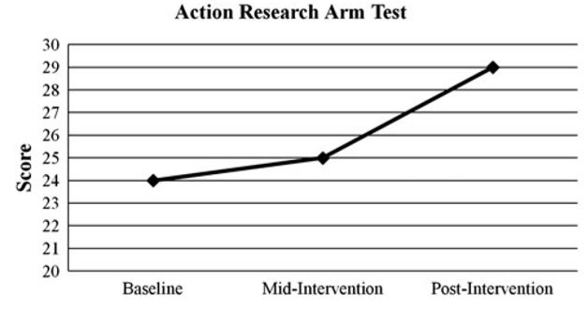
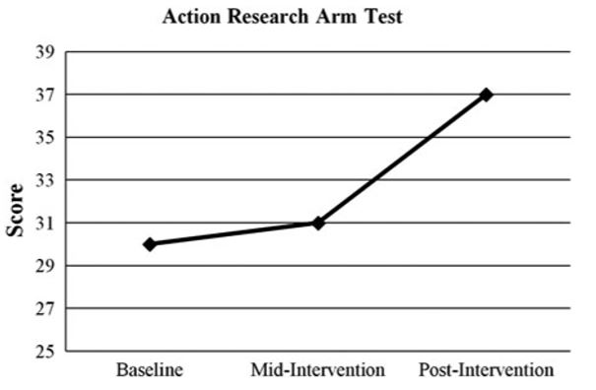
Results
3. ARAT
(1) First participant indicating a 5 point change in upper extremity function.
(2) Second participant indicating a 7 point change in upper extremity function.

Slide 9
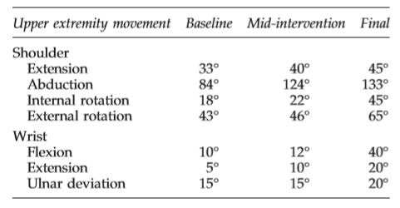
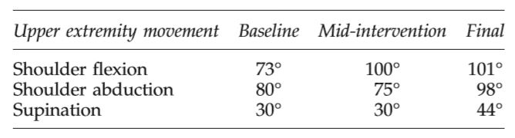
Results
4. ROM
(1) All participants improved their ROM.

Slide 10
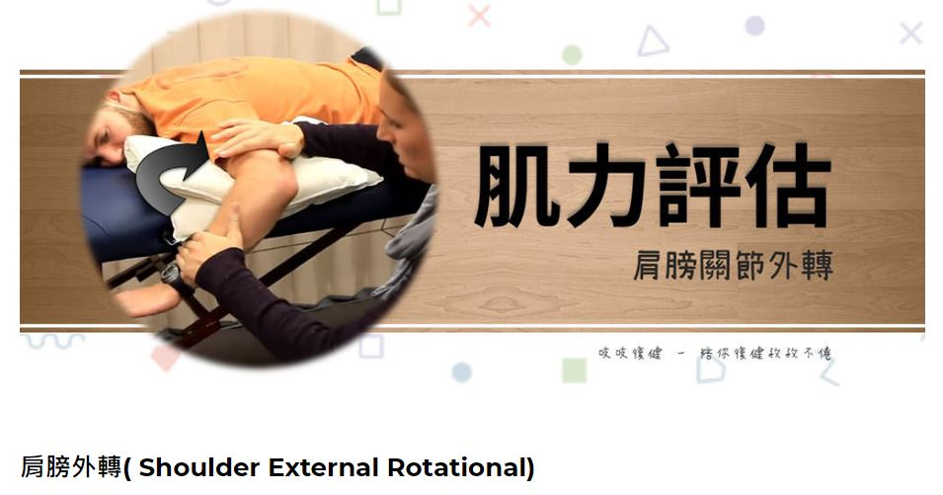
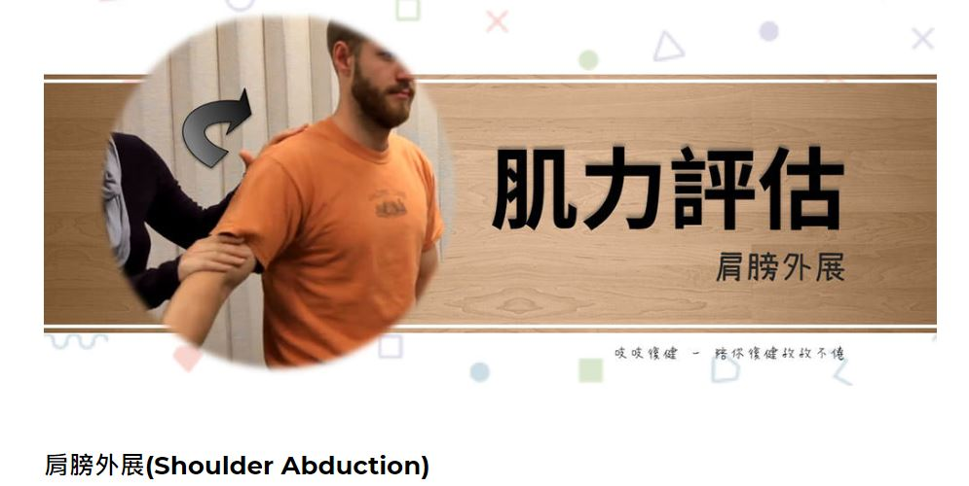
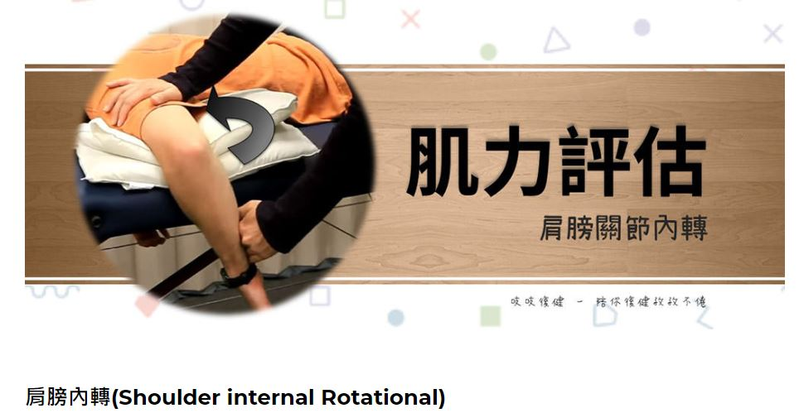
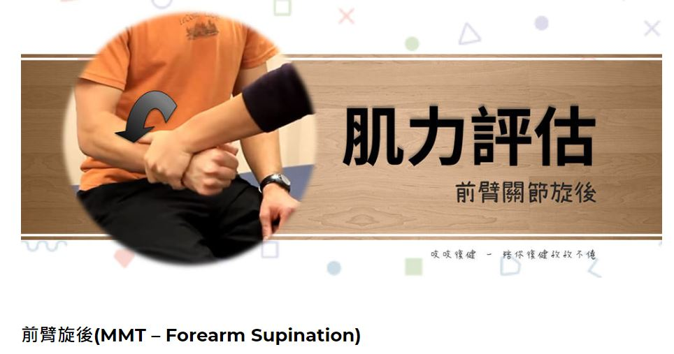

Slide 11
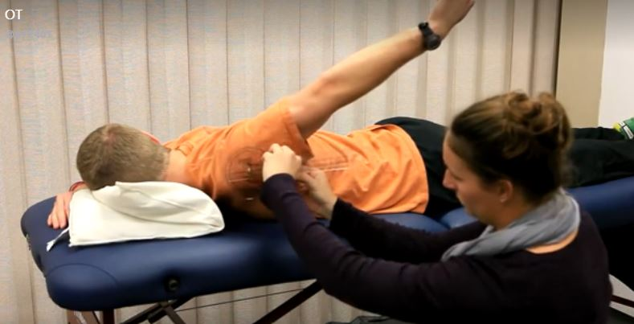
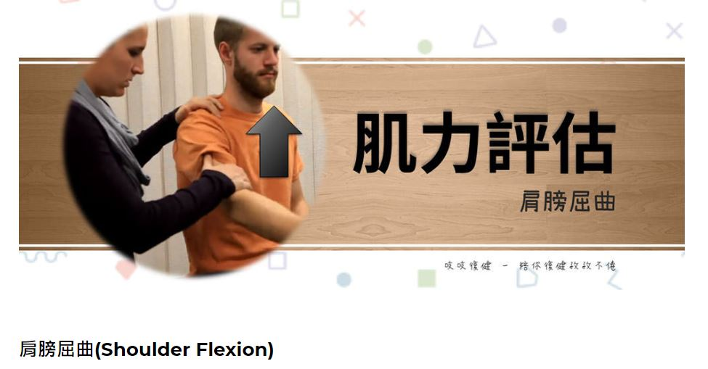
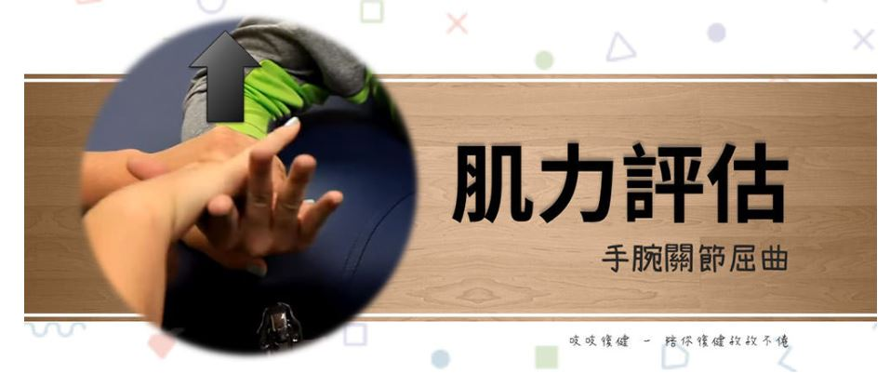
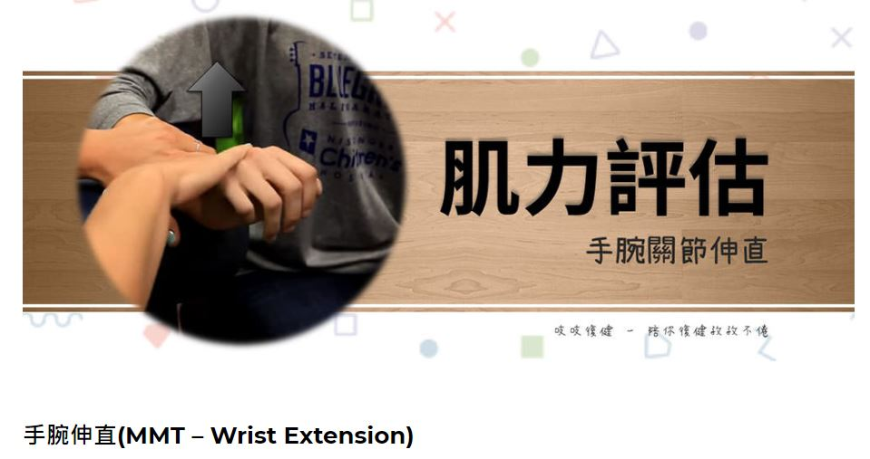
Shoulder Extension
Wrist Flexion

Slide 12
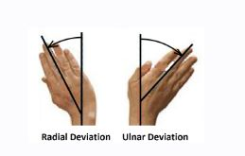
尺侧倾斜
ROM的演示视频见https://relive.tw

Slide 13
Conclusion
1. VR, as a home therapy intervention, has the ability to create a motivating environment that is individualized to patients, encouraging massed practice of repetitious movements.
2. This study reinforces the notion that changes can continue to occur 6 months post-stroke due to neuroplasticity.

Slide 14
Limitations
1. A small sample size of two.
2. We were unable to track all the functional changes that occurred.

